Slide 1
Start Recording!

Slide 2
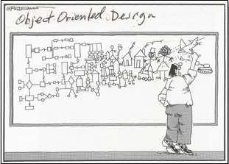
Welcome to OOP-2- Java!

Slide 3

Learning the gentle art and wisdom of writing clean, efficient code…
Introduction to Object-Oriented Programming in Java 2

Slide 4
Professors
Add any introduction materials you wish here

Slide 5
Start of Week 1

Slide 6


About the course

Slide 7
Course Evaluation
Professor Factor
Breakdown | Percent
In Class Labs | 10%
Quizzes/Assignments | 30%
Midterm Exam | 25%
Final Exam | 35%
You must have an average of 50%
across both exams in order to pass this course!
Notes:
I usually discuss the “professor factor” which is based on whether I like you or not. If you’ve answered a question imperfectly but you’ve been a good student, participated, worked hard, etc, I’m more likely to give you the benefit of the doubt on the question. Feel free to remove it!

Slide 8
Important! Please Note
That all sections, including online, will have in-person exams!
Be sure that you are available to be on campus during these times.

Slide 9
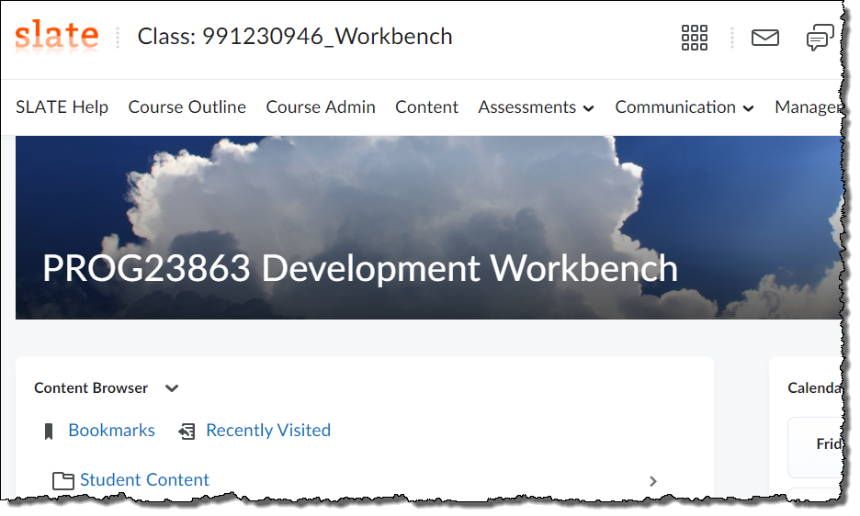
PROG23863 Object-Oriented Programming – Java Course Outline
Is located in your Slate Section.
Be sure to read through it!
Notes:
If you’ve correctly copied the course material to your Slate section, the Course Outline should be in the Student Content area

Slide 10
Week 1:
Introductions • Setting up VSCode • High-level programming languages • Memory architecture of the JVM • Variables
Week 8:
Inheritance • Overriding methods • visibility modifiers • Inheritance chains toString method • Abstract Classes and methods • Interfaces
Week 2:
The JVM under the covers • If statements • Loops • The Debugger
Week 9:
Garbage collection • Intro to Polymorphism • casting •.equals and .hashCode
Week 3:
Object-Oriented Programming • Using Objects • Building Objects • Methods Reference vs primitive variables
Week 10:
Dependency • Coupling and Cohesiveness • Button and the lamp • ArrayLists • Building our own ArrayList • Generics • HashMaps
Week 4:
Static variables and methods • Getting Input • Getters/setters • Throwing Exceptions • Constructors • Encapsulation/Abstraction
Week 11:
Event-driven programming • Inner classes • Anonymous classes • Lambdas • Functional Interfaces
Week 5:
Try/Catch • Method overloading • Pass by value • Final • Enumerated types • Deeper into Enums • Holding a reference to other objects
Week 12:
Functional Programming • Collections • Streams
Week 6:
Arrays • Arrays of Objects • Building a Stack • Review
Week 13:
Linked Lists • Review
Week 7 – Midterm Exam
Week 14 – Final Exam

Slide 11
Week 1:
Introductions
Setting up VSCode
Types of high-level programming languages
Memory architecture of the JVM
Variables

Slide 12
Week 1 – Getting up to speed with Java
First things first…we need an IDE!
We will be using VSCode in this course.
All assignments, quizzes, and exams will assume you are using VSCode
However, vanilla VSCode doesn’t know much about Java so we’ll have to fix that!
If I catch you using Notepad++, I will steal your lunch money!

Slide 13
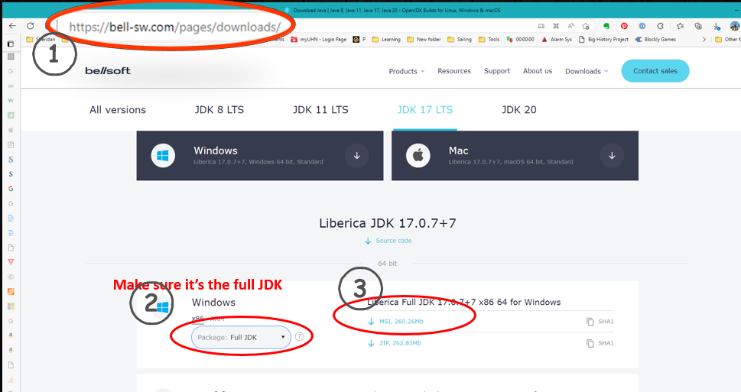
Installing the JDK
Notes:
We want this JDK because it will work with JavaFX. We aren’t using a lot of JavaFX in this course but there is at least one demo that requires it.

Slide 14
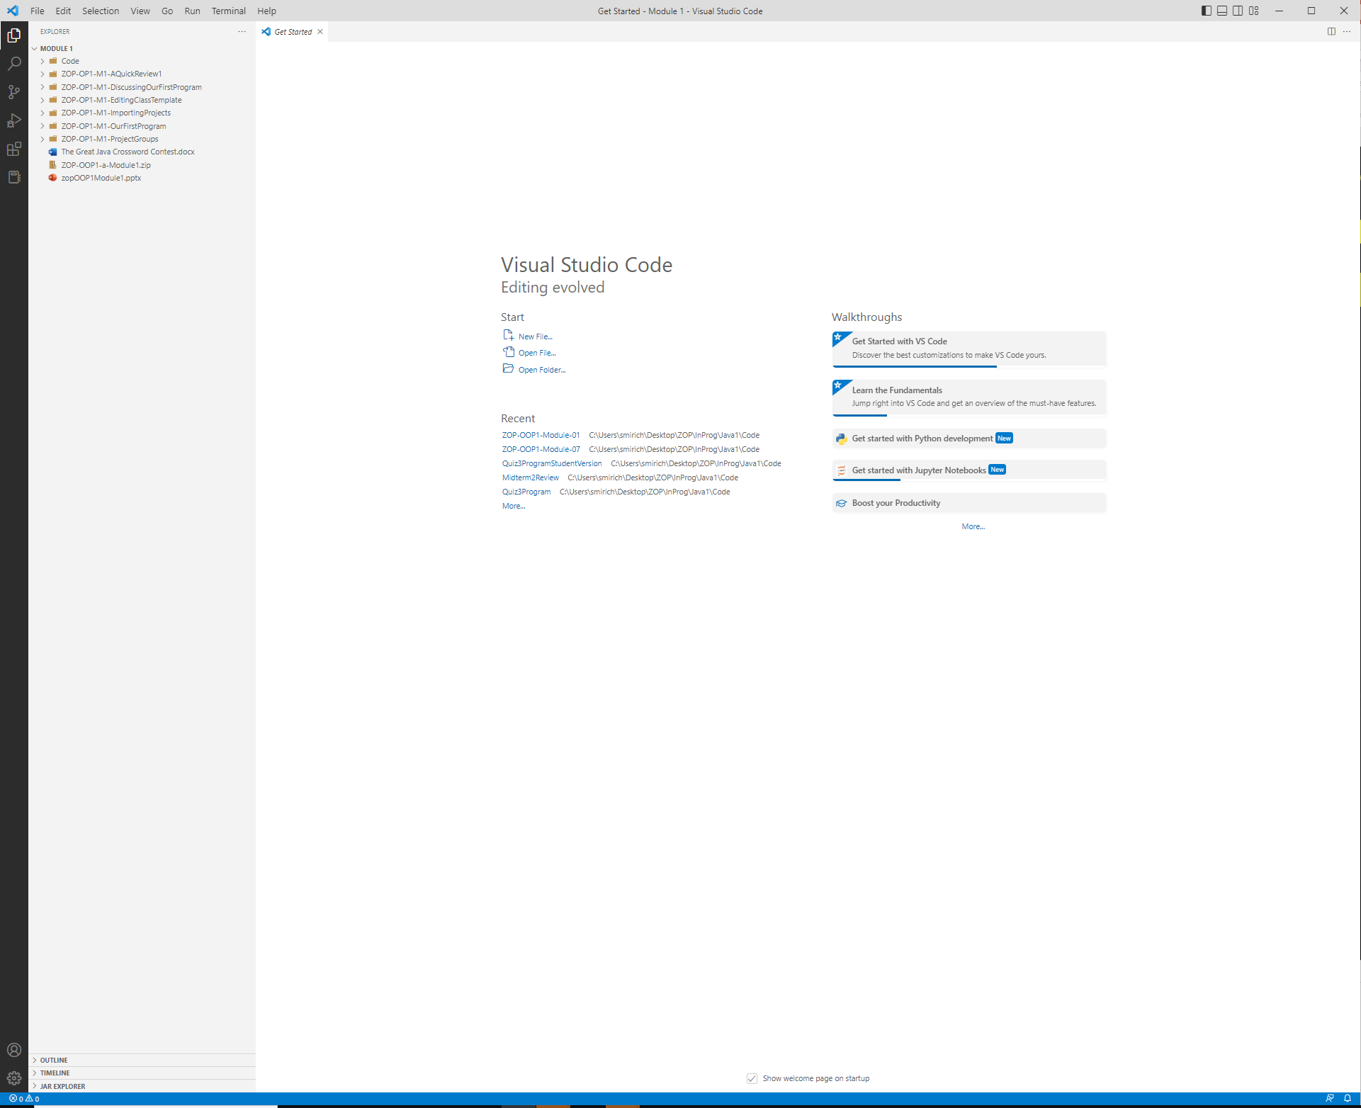
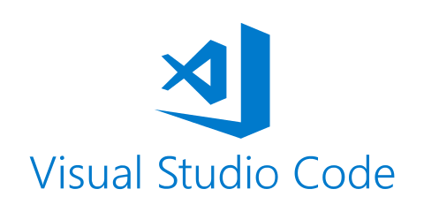
Installing VSCode if you don’t already have it Updating VSCode if you do! Loading Week-01 Code
Week-01
Notes:
Show them how to install VSCode for java or how to upgrade VSCode to run java if it is already installed.
Show them how to pull the Week-01 code from Slate, unzip it, and open it in VSCode
The slides following show how to install VSCode and add extensions if you need them

Slide 15
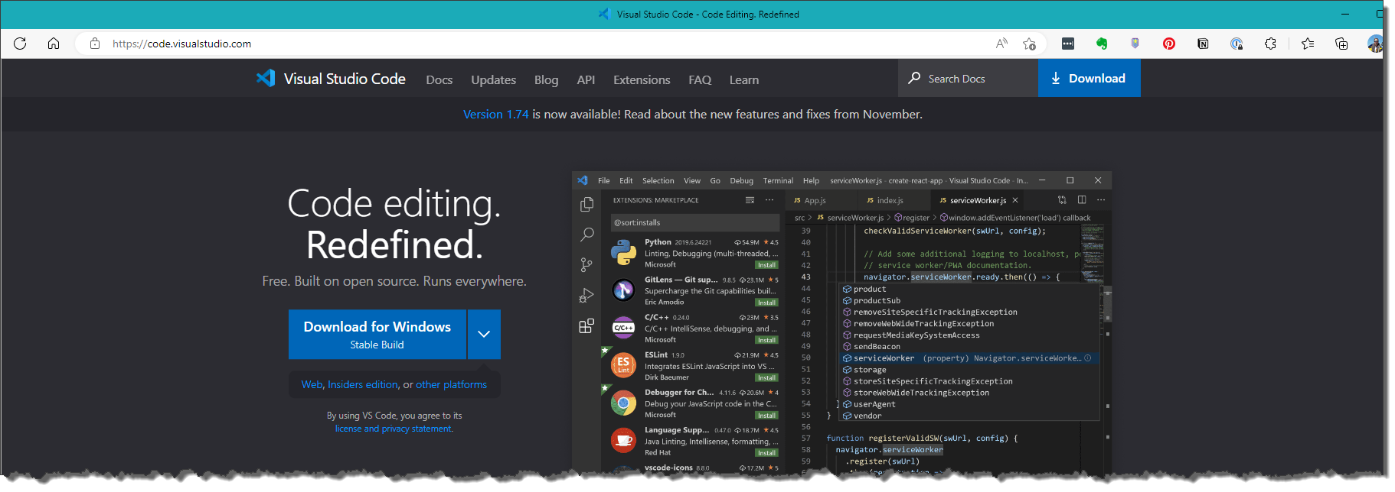
Installing VS Code
Go to https://code.visualstudio.com/ and download VSCode for your computer.

Slide 16
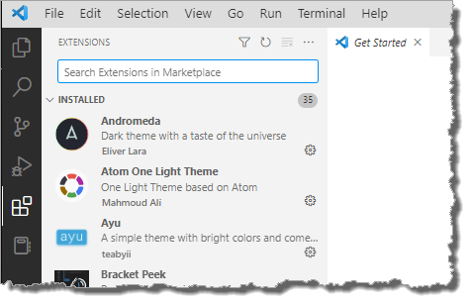
Installing VSCode
Open VSCode and click on the Extensions icon:
Search for and install the following extension:
Extension Pack for Java
Notes:
The student MUST install Extension Pack for Java.

Slide 17
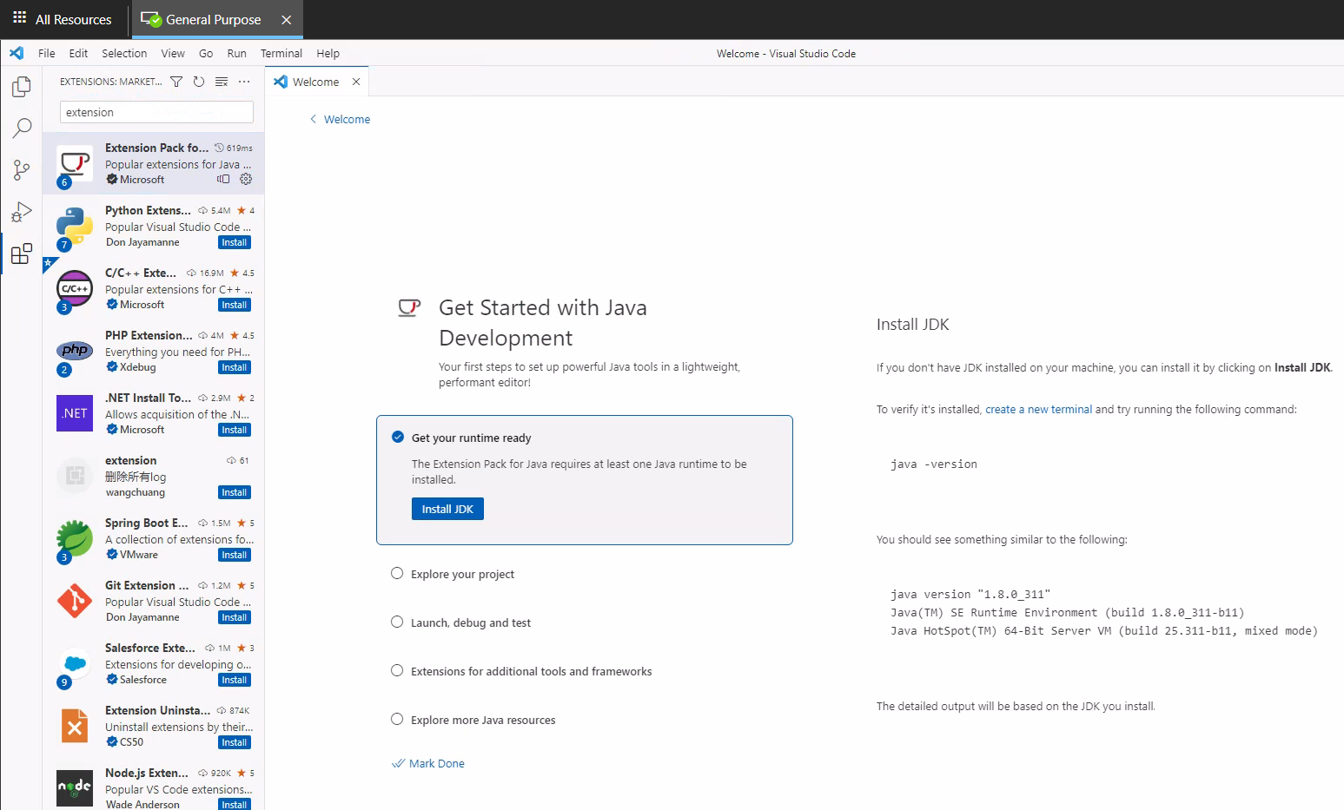
If you don’t already have a JDK Installed, you may see this….
Click here!

Slide 18
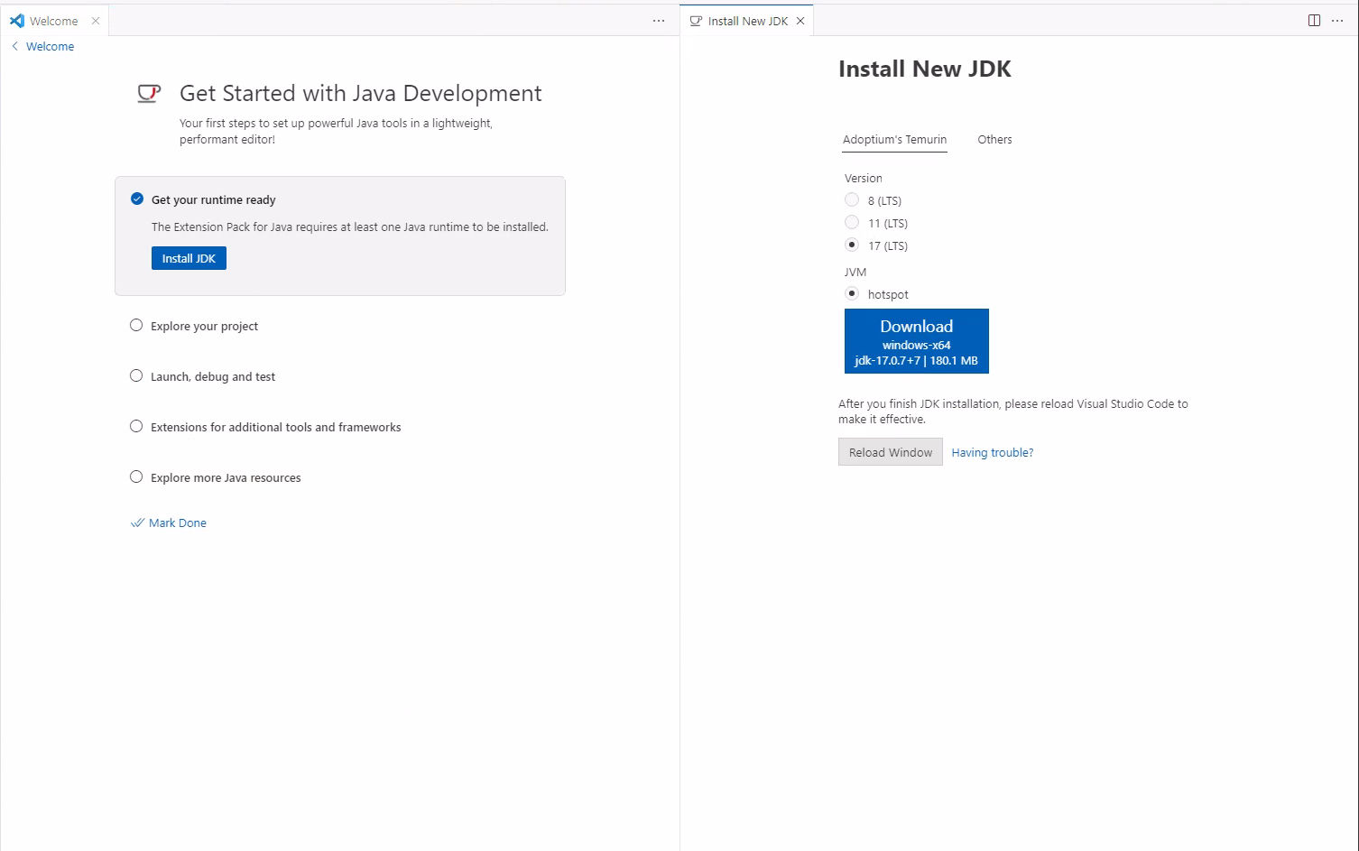
Choose this one!

Slide 19
Installing VSCode
Open VSCode and click on the Extensions icon:
Search for and install the following extensions:
Extension Pack for Java
Error Lens
PDF Viewer (by Mathematic inc)
VS-Code Icons
Print
JVM Bytecode Viewer
Fold on Open
Comment Styler
Notes:
It is HIGHLY RECOMMENDED that both the students and the profs install these extensions. They will make the course experience and the program experience much better.

Slide 20
Download the course code
Download ZOP-OOP1-Java-Week-01.zip from Slate
Unzip this file into a folder where you wish to keep all the slides and code for this course
For example:
OOP1-Java -> Code -> ZOP-OOP1-Java-Week-01

Slide 21
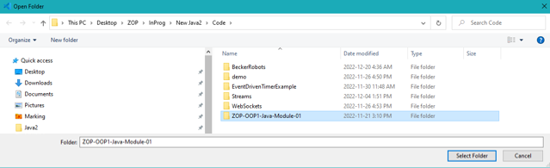


Download the course code
Open VS Code and select File -> Open Folder
Navigate to and select ZOP-OOP1-Java-Week-01
click Select Folder (do NOT navigate into the folder – just select the folder and click Select Folder)
Hint: If things aren’t working right, you’ve opened the wrong folder! It has to be the folder immediately above the one with the src folder

Slide 22
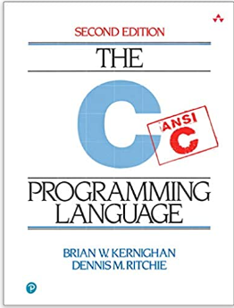
OK, we have an IDE Where do we start ???
Hello World
A bit of history…
Week-01:helloworld:HelloWorld
Notes:
Some history around HelloWorld
The C programming language was created by Dennis Ritchie in 1972.
The C language marked a huge change to the programming world. Before C, languages were clunky, slow and awkward (Cobol, Fortran etc).
C was the first of what could be referred to as modern programming languages. Many of the concepts introduced in C are still part of languages like Python or Java.
In that same year, Dennis and Brian Kernighan wrote a book called: “C programming Language” This book went on to become the proverbial bible that every programmer worth their salt had a dog-eared copy of.
The very first program presented in that book was a program called HelloWorld that printed out “Hello World!”
Since that time, programmers have paid tribute to these two men by writing a HelloWorld equivalent as their first program in any new language that they learn!
HelloWorld is the perfect fist program as it is as simple as can be, while still requiring the structure of the language to be appreciated
So, as you write your first HelloWorld in java, know that you are a part of the fellowship of programmers, a long lineage of programmers throughout history! Pretty much any piece of software that you care to name was written by someone who started with HelloWorld, just as you are doing now!

Slide 23
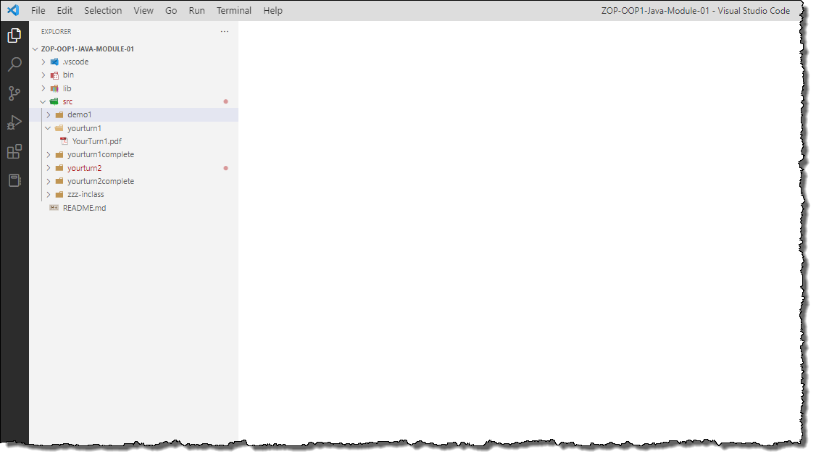
Writing our First Java Program!
Open the src folder and then yourturn1 folder.
Click on the YourTurn1.pdf file and follow the directions
Notice that every yourturn has a yourturn complete where you can see the completed exercise

Slide 24
A little friendly advice…
You may be tempted to copy and paste code from one exercise to another…
My advice: DON’T!!!
Always type everything in fresh for each exercise!!!
I promise that you’ll be happy that you did by the end of the semester!!!

Slide 25
src/yourturn2
Fix the errors!

Slide 26

Object-Oriented Programming in Java
Learning the gentle art and wisdom of writing clean, efficient code…
Week 1:
Types of High-level Programming Languages
Notes:
15 minutes
Explaining the difference between fully scripted, fully compiled, and hybrid languages

Slide 27
There are 3 kinds of programming languages
Fully Interpreted (Scripted) – JavaScript, Python, PHP
Fully Compiled – C, C++
Hybrid – Java, C#

Slide 28

Fully Scripted Languages
VBScript, JavaScript, PHP, Ruby, Python
Source code file:
#include <stdio.h> main() { for(;;) { printf ("Hello World!\n"); } }
Hard Drive
Interpreter converts source code into machine code while the program is running
#include <stdio.h> main() { for(;;) { printf ("Hello World!\n"); } }
Interpreter
110100100110101110110110
SLOW!!!
Operating System
Computer Hardware
Notes:
Fully-scripted languages are slower than fully-compiled or hybrid languages

Slide 29
Fully Compiled Languages
C, C++, Pascal, Objective C and ADA
110100100110101110110110
Source code file:
#include <stdio.h> main() { for(;;) { printf ("Hello World!\n"); } }
Machine Code
(Hard Disk)
Compiler
110100100110101110110110
Very Fast!!!
Hmmm...What if I want to run this program on a different Operating System?
Application Executable
Operating System
Computer Hardware
Notes:
Compiled languages run much more quickly than fully-scripted languages but do come with their own baggage when porting to other OS

Slide 30
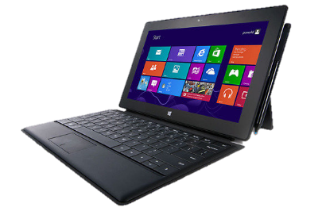


High Development Costs of fully compiled languages!
Windows Programmer
$$$
Windows Executable code file:
11010101110101000111010100111010101010101000
Windows Source code file:
#include <stdio.h> main() { for(;;) { printf ("Hello World!\n"); } }
Compiler
Mac Programmer
Mac
Source code file:
#include <stdio.h> main() { for(;;) { printf ("Hello World!\n"); } }
Mac
Executable code file:
11010100011010101000110111011100111101010101
Compiler
Linux Programmer
Linux
Source code file:
#include <stdio.h> main() { for(;;) { printf ("Hello World!\n"); } }
Compiler
Linux Executable code file:
00011010100001010101010111101000001010001111
Notes:
Need a compiler for each OS that you plan to ship on
Need programmers for each OS
Need to manage 3 separate code bases
Etc.

Slide 31
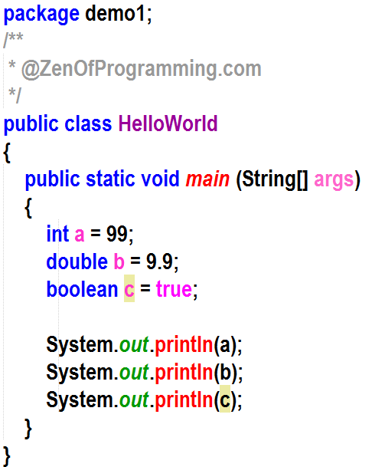
Java: The best of both worlds
0: iconst_2 1: istore_1 2: iload_1 3: sipush 1000 6: if_icmpge 44 9: iconst_2 10: istore_2
Source code is stored in a .java file
Bytecode
Bytecode stored in a .class file
Compiler
Bytecode
Application Bytecode
Application Bytecode
Application Bytecode
Programmer
0: iconst_2 1: istore_1 2: iload_1
0: iconst_2 1: istore_1 2: iload_1
0: iconst_2 1: istore_1 2: iload_1
Java
API
JVM
Java
API
JVM
Java
API
JVM
11101
00101
10101
Linux OS
Mac OS
Windows OS
Java Virtual Machine
Computer Hardware
Computer Hardware
Computer Hardware
Notes:
Hybrid languages a middle-ground where our code runs faster than fully-scripted, while still maintaining the portability

Slide 32
Java Costs are Lower!
Windows Source code file:
#include <stdio.h> main() { for(;;) { printf ("Hello World!\n"); } }
Compiler
ByteCode file:
11010101110101000111010100111010101010101000
1 programmer
1 computer
free compiler

Slide 33
BTW…Where did the Compiler and the JVM come from?
JVM – Java Virtual Machine (java.exe)
converts bytecode into machine code in real time
Is contained in the JRE (Java Runtime Environment) along with the Java API (our library of free code like System.out.println())
Java API
A library of java code that we can use while writing our programs
JRE (Java Runtime Environment)
The JRE contains the JVM and the Java API
The JRE ships with virtually every computer operating system out there
Can be found in Android phones, gas station pumps, toasters, TVs, etc.
JDK (Java Development Kit)
Only programmers need the JDK.
The JDK must be downloaded (typically does NOT ship with OS)
The JDK contains the Compiler (javac.exe)
The JDK also contains a JRE that is the same version as the Compiler

Slide 34

By the way, Python costs are also low
However, Python is slower!
Why do you think that is?
Notes:
Python is slower because it is fully scripted. The interpreter must convert all the way from source to machine code while the program is running.
The java JVM just has to convert from bytecode to machine code while the program is running.

Slide 35
C++ vs Python vs Java
Truth is, once you know one language, you pretty much know them all!
There are differences in syntax between languages but they are all built upon the same core principles:
Sequence (code runs in order)
Decision (code can branch depending on a condition)
Iteration (code can loop over and over)

Slide 36
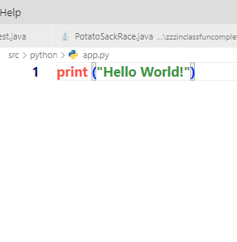
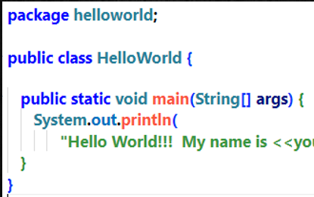
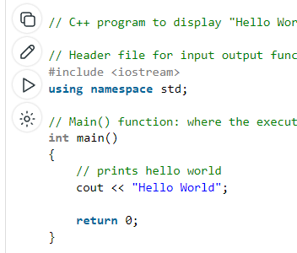
Hello World!
Python
Java
C++
(Fully Scripted)
(Hybrid)
(Fully Compiled)
Notes:
Notice that Python is much more succinct than the other languages. This is one of Pythons great attractions.
Java is more verbose but it does have some advantages over Python. As with everything else in life, there are trade-offs between the two languages

Slide 37
Python vs Java
Python
Dynamically Typed
Interpreted
Highly readable and concise
Harder to debug
Runs everywhere
Very active developer community
Machine Learning/Science
Is starting to dislodge Java
Has CLI (Command Line Interpreter)
Slower
Java
Statically Typed
Hybrid
More verbose but more structured
Easier to debug
Runs Everywhere
Huge Legacy of code
Scales better than Python
Strong in web development (starting to erode vs javascript at the backend)
Strong in embedded systems
No CLI
Faster
Bottom line? Learn them both…looks good on a resume!
Notes:
The pros and cons of Python vs Java
Java has a huge legacy base, lots of jobs, and is great for web apps
Python has huge momentum, active community and great for AI and machine learning
Don’t get too hung up on one language vs another. Once you understand the fundamentals of programming, languages are easy to learn
Being too set on one vs another will limit your career path options.
One thing that is different and important is that Python is dynamically typed so the type of a variable is determined during runtime vs Java, which is statically typed – meaning we must know the type of the variable at compile time (or design time), while we are writing the code

Slide 38
Python Syntax vs Java Syntax
Python
Indentation
Concise
Java
{ }
Verbose

Slide 39
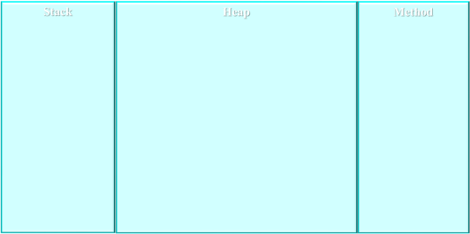
Let’s zoom in...
Application Bytecode
0: iconst_2 1: istore_1 2: iload_1 3: sipush 1000 6: if_icmpge 44 9: iconst_2 10: istore_2
Talks bytecode
JVM Memory
JVM
Java
API
101010100
010110100
100101010
Talks machine code
Operating System
Computer Hardware

Slide 40
Hello World, Bytecode Style! And…Introducing the debugger
Week-01:helloworld:HelloWorld
Notes:
Show the bytecode:
Ensure that you have the “JVM Bytecode Viewer” extension installed.
Go to the helloworld/bin directory, right click on HelloWorld.class, and select “Show Bytecode (Verbose)”
The compiler took our HelloWorld.java sourcecode file and compiled it into this bytecode. This is the code that the JVM will load into the method area of memory and interpret into native machine instructions
Show the debugger in action:
Put a breakpoint on the first line of the method (click to the left of the line number until the red dot shows up) and show the students how to add the breakpoint.
debug the program. Continue to step into it for a while to show the students how much work is being done just to print out HelloWorld
Perhaps point out how, as you step into methods, the stack frames are stacking up in the stack – mention that this will become important to us later

Slide 41
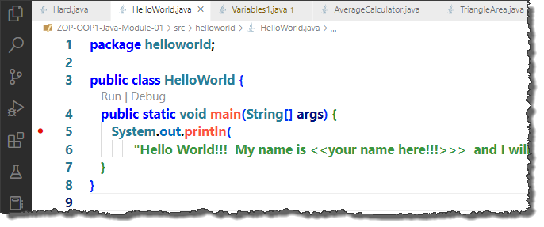

Introducing the DEBUGGER!
Think of the debugger as a combination Freeze-Ray and X-Ray Machine
Step into button
Debugger control panel
breakpoint
We will use the debugger a lot in this course. This is just a small taste of what it can do!

Slide 42
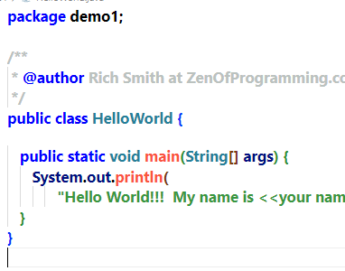
Let’s look at our code
Class Name
Class Header
Method Header
Class code block - everything between the { }s
Method code block - everything between the { }s

Slide 43
A Handy Guide to ;
If we come to the end of a line of code and the next character in our program is NOT a { then we add a ;
If the next character IS a { then we DO NOT add a ;

Slide 44
Let’s Review: Who am I?
I am the brains of the computer.
CPU
I consist of 1’s and 0’s
Machine code (binary code)
I only understand 1’s and 0’s
Hardware (cpu)
I translate java source code into bytecode
compiler

Slide 45
Who am I?
I contain the compiler and the Java Runtime Environment.
JDK – Java Development Kit
My filename is javac.exe
Compiler
I contain the Java Virtual Machine and the Java API.
JRE – Java Runtime Environment
I interpret byte code into machine code on the fly
JVM – Java Virtual Machine
I am where smart students go to get extra help!!!
Professor, Learning Assistants

Slide 46
Who Am I?
I am the type of java code that programmers type into an editor like VSCode.
java source code
I am the code that runs natively on the computer hardware
machine code (1’s and 0’s)
I am an intermediate code that is lower level than source code but higher level than machine code.
bytecode

Slide 47
Who Am I?
I convert java source code into bytecode
Compiler
I interpret bytecode into machine code on the fly.
JVM
I contain the compiler that programmers use to compile java source code into bytecode
JDK
I exist on many operating systems, thus allowing java programs to be cross-platform.
JVM

Slide 48

Who Am I?
I am a fish with no eyes.
FSH!!!

Slide 49
Week 1:
The memory architecture of the JVM
Variables
Notes:
5 minutes

Slide 50
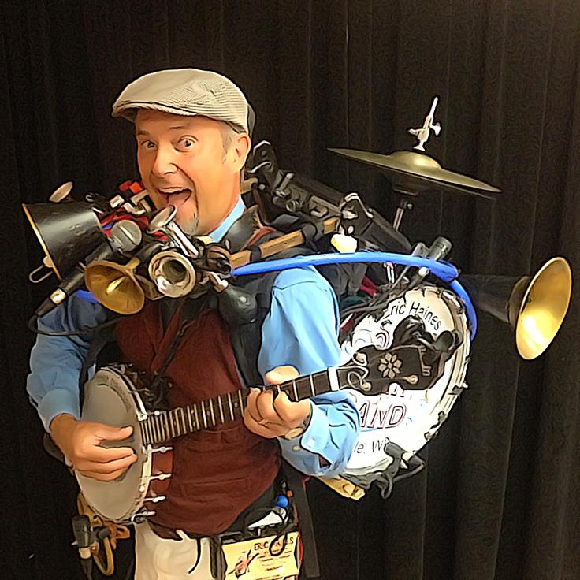

Why Bother?
Understanding how the JVM works is the difference between writing code like this...
And this!
Notes:
A lot of projects become a jumble of code with no organization, where everything is connected to everything else and making a change to one part of the program ends up breaking something in some other part of the program.
We want our components to work together to form beautiful music without negatively impacting each other.

Slide 51
The JVM memory footprint
Stack
Heap
Method
OK...This isn't exactly true...(but close enough!)
Notes:
So, the JVM requires memory in order to run your programs
When you start up the JVM, it will grab three chunks of memory…the stack, the heap, and the method area.
Now, this isn’t 100% true but, unless you plan to write your own operating systems, it’s close enough to true to be useful

Slide 52
The Class Loader and the method section
Stack
Heap
Method
All implementations of the JVM include something called a Class Loader.
A class loader loads the bytecode from our .class file into the Method Section of the JVM memory.
Whenever a class is loaded into memory, it is loaded by a Class Loader.
When our JVM starts running our code, it executes the bytecode from the Method Section, interpreting it into machine code.
The JVM always starts running the code in the method called main.
0: iconst_2 1: istore_1 2: iload_1 3: sipush 1000 6: if_icmpge 44 9: iconst_2 10: istore_2
0: iconst_2 1: istore_1 2: iload_1 3: sipush 1000 6: if_icmpge 44 9: iconst_2 10: istore_2
0: iconst_2 1: istore_1 2: iload_1 3: sipush 1000 6: if_icmpge 44 9: iconst_2 10: istore_2
Notes:
When you start to click on run inside of a class in VSCode, a bunch of things happen
Any uncompiled the classes in your project get compiled into bytecode and stored as bytecode in .class files in your bin directory
The JVM spins up and grabs a big chunk of memory and divides into three areas: the stack, the heap, and the method area
The bytecode from the file with the main method is loaded from the .class file on your hard drive by something called a “Class Loader” which is part of the JVM. The Class Loader loads the bytecode into the method area memory. Once the bytecode is in the method area, the JVM can start interpreting the bytecode that makes up the main method into machine code and your program starts running!
Remember, that our programs always start running in the main method.
Every time our program needs the bytecode from a new Class, the class loader will load it into the method area

Slide 53

Rules of the JVM
The JVM follows a set of simple rules in order to run a java program.
It follows these rules for EVERY Java program ever built
Rule #:
The first time a class is accessed, the JVM loads the bytecode from the .class file into the method area of memory.
The JVM always starts running our code at the beginning of the main method.
Notes:
These are the first two rules of the JVM – understanding how the JVM works will make you a much more effective programmer!

Slide 54
Week 1:
Variables – Part 1
Primitive Variables
Doing math with Variables
Notes:
20 minutes
Introduce primitive variables just follow along the notes in the demos

Slide 55
Good News!!!
We’re all java programmers now!!!

Slide 56
Bad News!!!
Nobody is going to pay us $200k per year to print out Hello World
Our programs should do something useful
Introducing Variables!!!

Slide 57
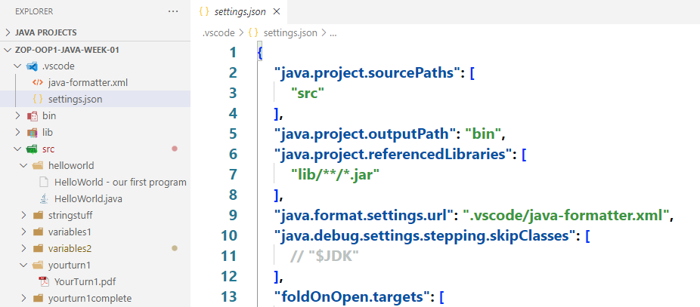
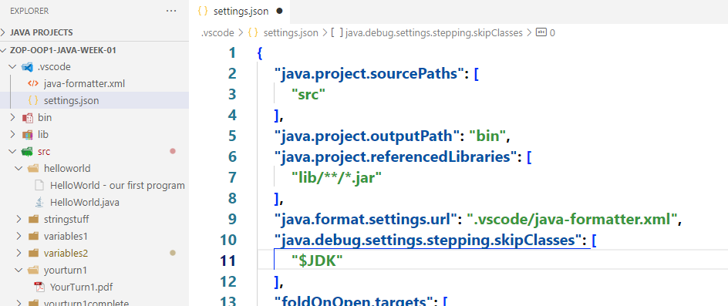
Before we do the next demo… we have to make a small change
Open settings.json in the .vscode folder
Uncomment this line so it looks like this (remove the //)
Save the file
Notes:
We need to tell VSCode not to step into the Classes contained in the JDK. If we don’t, every time we step into a println, it will start stepping into that code.
You could skip this and just use step over but it will cause the debugger to step into the threading class when it gets to the end of the method. You would need to remember to either end the debug session before the final } in the method or use step into at that point. It’s probably easier to just uncomment the line in the settings.json file.

Slide 58
Variables
Week-01:variables1:LearningVariables1
Week-01:variables1:LearningVariables2

Slide 59
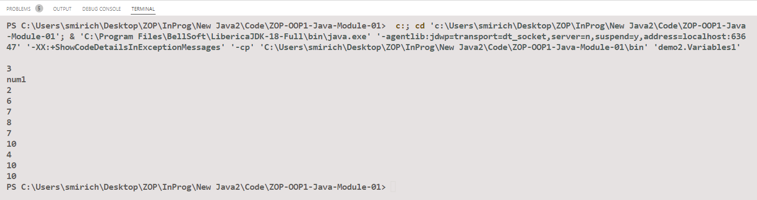
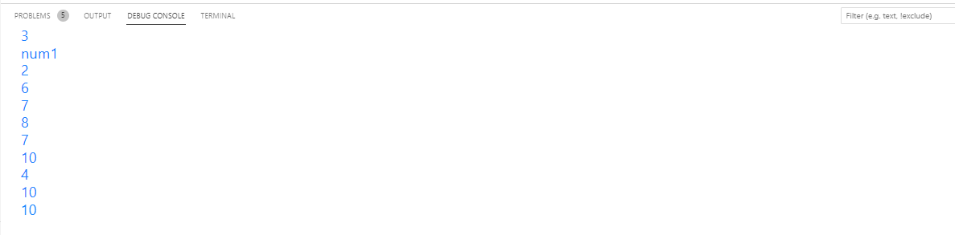
Did you notice that…
Your output looked something like this:
And mine looked like this:
Notes:
If you want to force VSCode to use the debug console instead of terminal, follow the next slide. It just makes the output less noisy

Slide 60
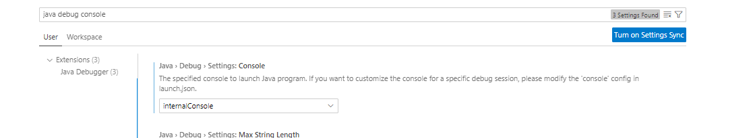
Viewing the Console instead of the terminal
If you’d like your output to look like mine,
Open VSCode Settings and start keying “java debug console” – then change to internalConsole

Slide 61
Pro Tip:
There are a zillion things you can configure in the settings.
We will set a few in this course.
However, YouTube and Google are your friends for finding stuff you want to customize.

Slide 62
Variables
Think of a variable as a little box in the computer’s memory that can contain a value.
Memory is part of the hardware.
If we could look inside memory, we would see:
1010110101010101010101011101000111010101

Slide 63
Variables
Each of the 1’s or 0’s is called a bit.
A bit can be on (1) or off (0)
8 bits make up 1 byte
1010110101010101010101011101000111010101
Using binary, 1 byte can store an integer value of between -128 to 128
What if we want to store a bigger number? Or some text?

Slide 64
Variables
It turns out that we have to create different size boxes in memory to store different sizes of numbers.
Think about storing a marble and a basketball in a box. We would need different size boxes, right?
We call these different sized boxes types.

Slide 65
Primitive Variables
Variable Type | Range | Amount of bytes of memory
byte | -128 to 128 | 1 (8 bits)
short | -32768 to 32768 | 2 (16 bits)
int | -2147483648 to 2147483647 | 4 (32 bits)
long | Really huge numbers | 8 (64 bits)
What about decimal numbers?
Variable Type | Range | Amount of bytes of memory
float | Very large range of decimal | 4 (32 bits)
double | Huge range of decimal numbers | 8 (64 bits)
Variable Type | Range | Amount of bytes of memory
boolean | true or false | depends

Slide 66
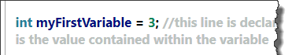
Anatomy of a variable declaration
Variable Name
We use camelCase for variable names in Java (first letter is always small and the beginning of any subsequent words is always Capital)
numberOfApples
calculatedSalesTax
Value (optional)
Variable Type
int
Double
boolean
etc

Slide 67
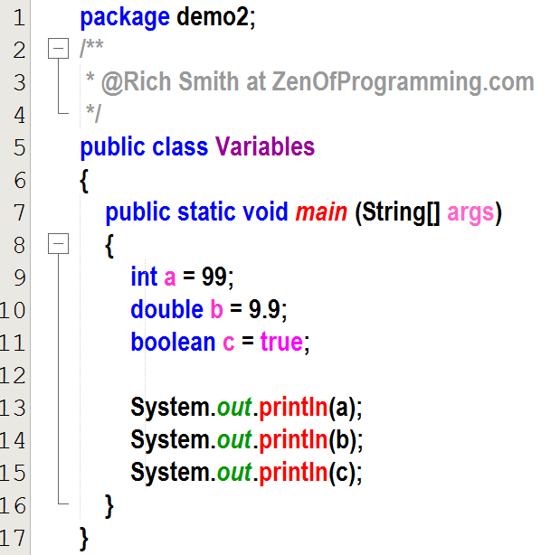
Review: Variables
Variables store information for us.
Before we can use a variable, we must declare what 'type' it is.
Once a variable is declared, it can never be declared again! We can't change an int to a double or a double to a boolean.
However, once we've declared a variable, we can put values into it and read the values stored in it.

Slide 68
Rules of the JVM
The JVM follows a set of simple rules in order to run a java program.
It follows these rules for EVERY Java program ever built
Rule #:
The first time a class is accessed, the JVM loads the bytecode from the .class file into the method area of memory.
The JVM always begins running the code in the main method
Variables whose type starts with a lower-case letter (int, double, boolean, etc) are PRIMITIVE variables. They store values that we can access later.

Slide 69
Statically typed vs Dynamically Typed
Languages like Python and JavaScript use dynamically-typed variables.
The type is determined during the runtime of the program (while the program is running)
We can use a variable as an int and then turn around and store a String in it
More flexible (Careful what you wish for!)
Slower
Statically-typed languages such as Java are not so forgiving.
Statically-typed languages check the type at compile time.
The compiler must know what a type of information we want to store in a variable at compile time. That means we must know what type of information that will be stored when we are writing the code
Also, we can never change what type of information that variable stores.
Takes a little longer to write but errors can be caught at compile time vs waiting until our code is running.
Faster
Professor’s Soapbox
Even when using a dynamically-typed language, it is a bad idea to store different types of data in a single variable. You can do, sure, but it makes for confusing and harder to maintain code.
Notes:
Key Points
Python is dynamically typed
Figures out variables at runtime
Can change the type of information stored in a variable at any time
Slower
Java is Statically Typed
We have to know what a variable type is at compile time
Can’t change variable types in midstream
Reduces hard-to-find bugs in your code
Faster
Regardless of what language you use, don’t switch the type of information stored in a variable once you declare it. At best it makes for confusing code and, at worst, it can introduce bugs into your code that are very hard to find
Languages like Python and JavaScript use dynamically typed variables.
The type is determined during the runtime of the program (while the program is running)
We can use a variable as an int and then turn around and use the same variable to store a String.
This is more flexible (which might not always be a good thing!)
Typically slower as the interpreter has to deal with the type during runtime
Statically Typed languages such as Java are not so forgiving.
Strongly typed languages check the type at compile time.
The compiler must know what a type of information we want to store in a variable at compile time.
Also, we can never change what type of information that variable stores.
Takes a little longer to write but errors can be caught at compile time vs waiting until our code is running.
Many newer programmers think of strongly typed languages as quaint but, after spending days looking for a bug that happens because the interpreter is mistakenly handling a variable as a type that the programmer didn’t expect, often changes their minds ;->
For example, many programmers have begun using TypeScript which is a scripting language the compiles into JavaScript (a dynamically typed language) so that they can catch these errors at compile time!)
Typically faster as types have been dealt with at compile time so the JVM doesn’t need to worry about it.
Professor’s Soapbox
Even when using a dynamically typed language, it is a bad idea to store different types of data in a single variable. You can do, sure, but it makes for confusing and harder to maintain code.

Slide 70

Your Turn!
Week-01: YourTurn3: PartA

Slide 71
It’s time to play…
What’s wrong with this code???

Slide 72
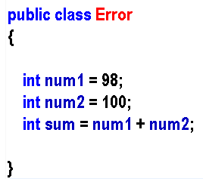
What is wrong with this code?
No method!

Slide 73
Let’s Fix it!
No method!

Slide 74
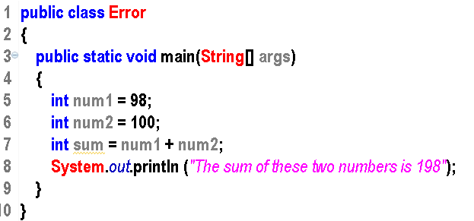
What is wrong with this code?
Let the variables do the work!

Slide 75
Let’s fix it…
Let the variables do the work!

Slide 76
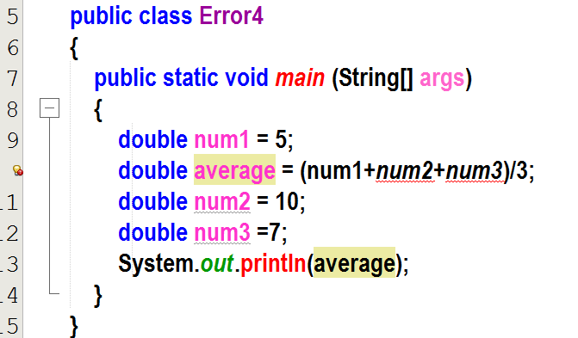
What is wrong with this code?
Code runs sequentially!

Slide 77

Let’s fix it!
Code runs sequentially!

Slide 78
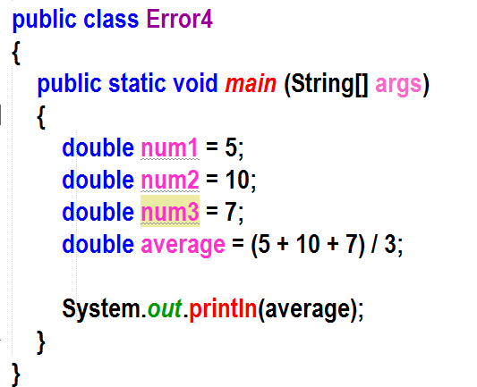
What is wrong with this code?
Let the variables do the work!

Slide 79
Let’s fix it!
Let the variables do the work!

Slide 80
Review: Tell me something about variables
???
Notes:
Ask the students to tell you any fact about variables and type it in here. Try to get them to discuss:
How to declare
Naming convention (camelCase)
A variable must be declared before it can be used
Can’t declare the same variable more than once
Stores values that we can write into or read from
Java recognizes the variable name. If we put “ “ around it, Java just thinks it’s a string of letters
Primitive types start with lower case – int, double, boolean etc.

Slide 81
Review: Tell me something about variables
Must declare before using
Can only be declared once
Type is checked at compile time vs runtime
If their type starts with a lower case, it is a primitive variable (built into the java language)
Store values for us to use
Should be named using camelCase
Notes:
This is the same slide as previous but with answers

Slide 82
Hmmm…Strings and stuff
Week-01:variables2:StringStuff
Week-01:variables2:UnderstandingStrings
Week-01:variables2: AreaOfACircle

Slide 83
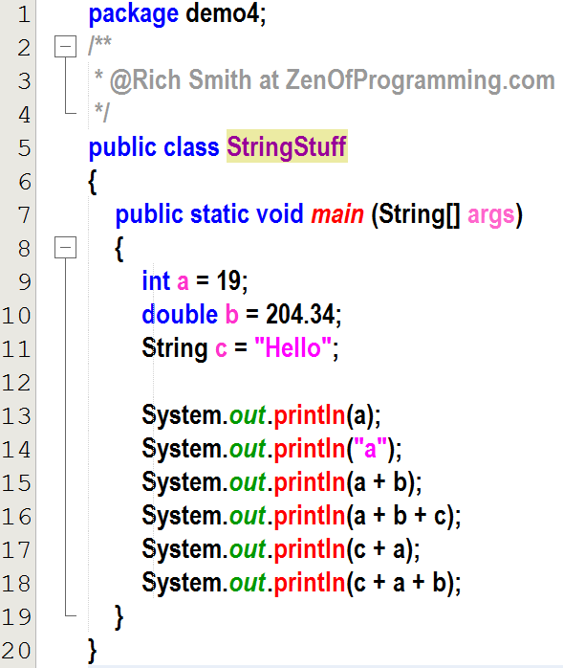

StringStuff
A String is a variable that contains a ‘String’ of characters.
Strings are never numbers…even if they hold characters that look like numbers
Strings are a little bit magic for now…I promise that we will learn more about them later.
For now, just remember that a String holds characters, not numbers!

Slide 84
Concatenation
When we add two numbers (ints, doubles etc), we get an answer that is also a number. We have performed math.
However, when we add two Strings together or a String and a number, we get an answer that is a String. We have performed concatenation.
Prints 223.34 (Math!)
Prints Hello19 (String Concatenation!)

Slide 85
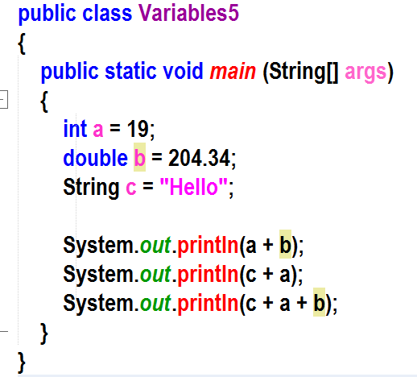
Strings vs int vs double
int variable type
int literal
String literal
does math to add two variables
String
Variable type
uses concatenation to add letters together
Hmmm…uses concatenation to add letters together – Hello19204.34

Slide 86
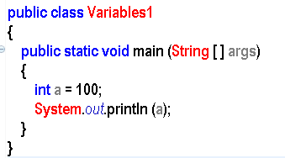
Reminder: We need to know this terminology!
Class Name
Class Header
Method Header
Declaring a
Primitive Variable
Class
Codeblock
Method
Codeblock
Print to the screen
KNOW THIS!!!

Slide 87
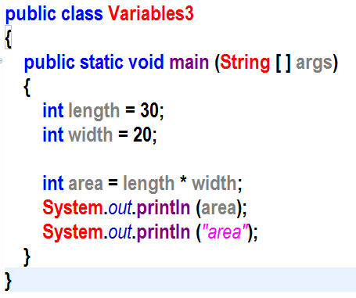
Quick Review
The integer variable called area:
contains the integer value of 600
“Quotes” make all the difference
String literal: contains the word area

Slide 88
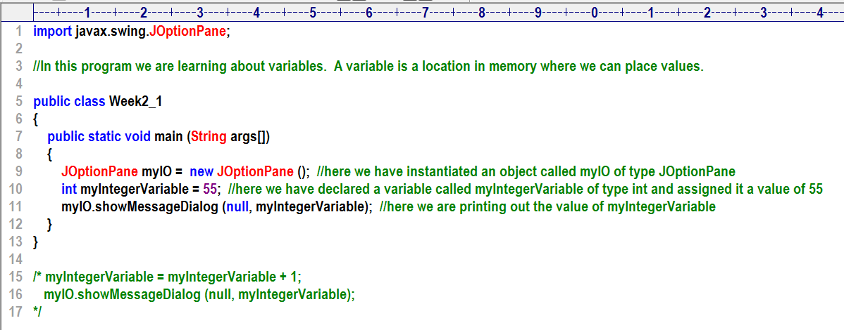
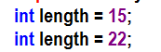
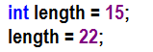
Some Facts about Variables
You must declare a variable before you can use it.
You can only declare a variable once. However, once you declare a variable, you can use it over and over again
Type
Variable name
Value (This is optional)
This will give you an error
This won’t give you an error

Slide 89
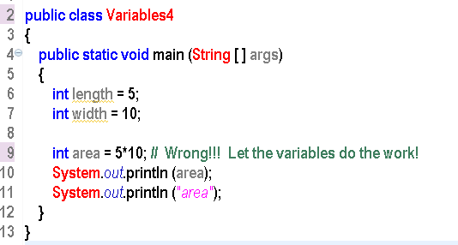
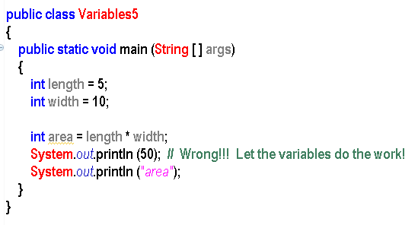
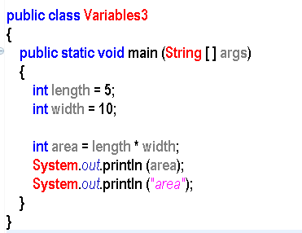
A Common Mistake that beginners make...
Let the variables do the work!!!

Slide 90
An advertisement for clean code

Slide 91
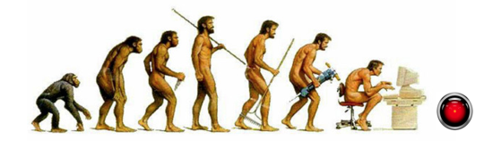
Software Lifespan
https://mitosystems.com/software-evolution/
Average lifespan of a computer program is 6-8 years.
Larger programs live longer
90% of software development cost is in the maintenance!
Notes:
In the old days, memory and computing power were very expensive. Programmers who could write code as compactly as possible were held in high esteem. It didn’t matter if it wasn’t very readable because the memory was so expensive

Slide 92
Times have changed
In the old days, processing power and memory was very expensive.
small, efficient code reigned.
It didn’t matter how readable it was.
Today, readable code is paramount.
People that write easy-to-read code make the most money.
Inline comments are an apology for not writing easily readable code!
Comments get out of sync with the code over time.
Well written code remains readable over time.
Notes:
Today, those same programmers would not be able to get a job! Memory is cheap! Processing power is cheap! The real cost of software now lies in the maintenance of the software! Only 10% of the cost of software is in the initial writing of the code. The other 90% of the cost is maintaining and adding to software.
Please note!!! The comments line is my opinion…it may not be yours! Feel free to remove it. (I’m a big fan of using javadocs to document methods for the API but I’m not a fan of inline comments except in the case of some sort of hard-to-understand algorithm. If we write our code with meaningful names, it becomes 90% self-documenting.

Slide 93
Naming Variables and Stuff
Description | Variable Type | Variable Name
Number of onion rings | int | numOnionRings
Change owed to customer | double | customerChange
Temperature of the fridge | double | fridgeTemp
Name of student | String | studentName
Name of professor | String | profName
Is the gate open | boolean | gateOpen
Percent of cell phone battery charge | double | cellPercentBattery
“The three hardest things in computer programming are off by one errors and naming things” ;->

Slide 94
Yourturn3: Part B, Part C, Part D
Notes:
10 minutes

